Slide 1
MQ Marketplace
Campus Marketplace Web Application
COMP2750
Callum Sonter
Jordan Puleitu
MD Tanjil Alam Emon
Zhang Bowei

Slide 2
Application Overview
What We Built
Tech Stack
Firebase Authentication - email/password sign in
Firestore database for persistent item storage
Marketplace - view other users' items
My Listings - view your own listed items
My Shortlist - save and manage favourite items
Authentication guard - redirects unauthenticated users to login
HTML - Page structure
CSS & Bootstrap - Styling & layout
JavaScript - Logic & interactivity
Firebase Auth - User authentication
Cloud Firestore - Database & storage

Slide 3
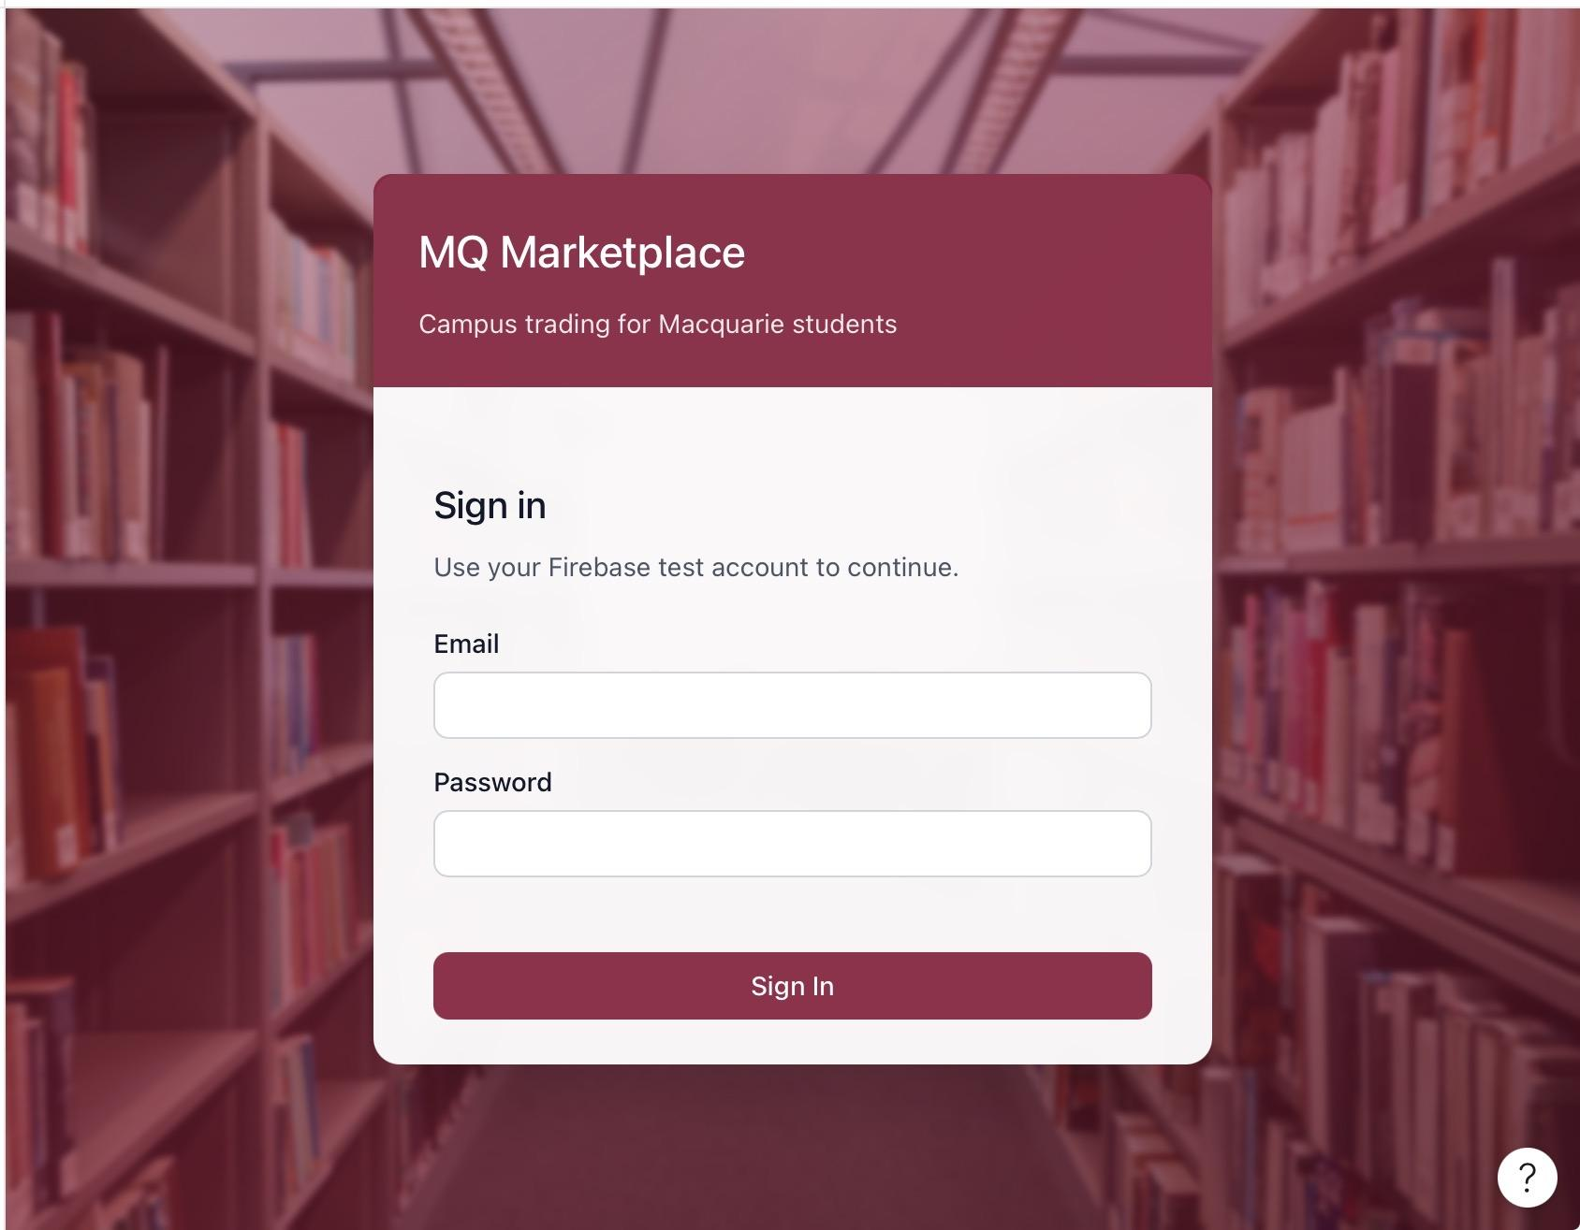
Firebase Authentication & Login Page
login.html
Figma Design
Build login.html to link entry point to webpage
Uses firebase authentication to verify email and password
Shows feedback when sign in is successful or unsuccessful
Redirects successful users to index(welcome) page
Supports access controls by requiring users to sign in before accessing the marketplace

Slide 4
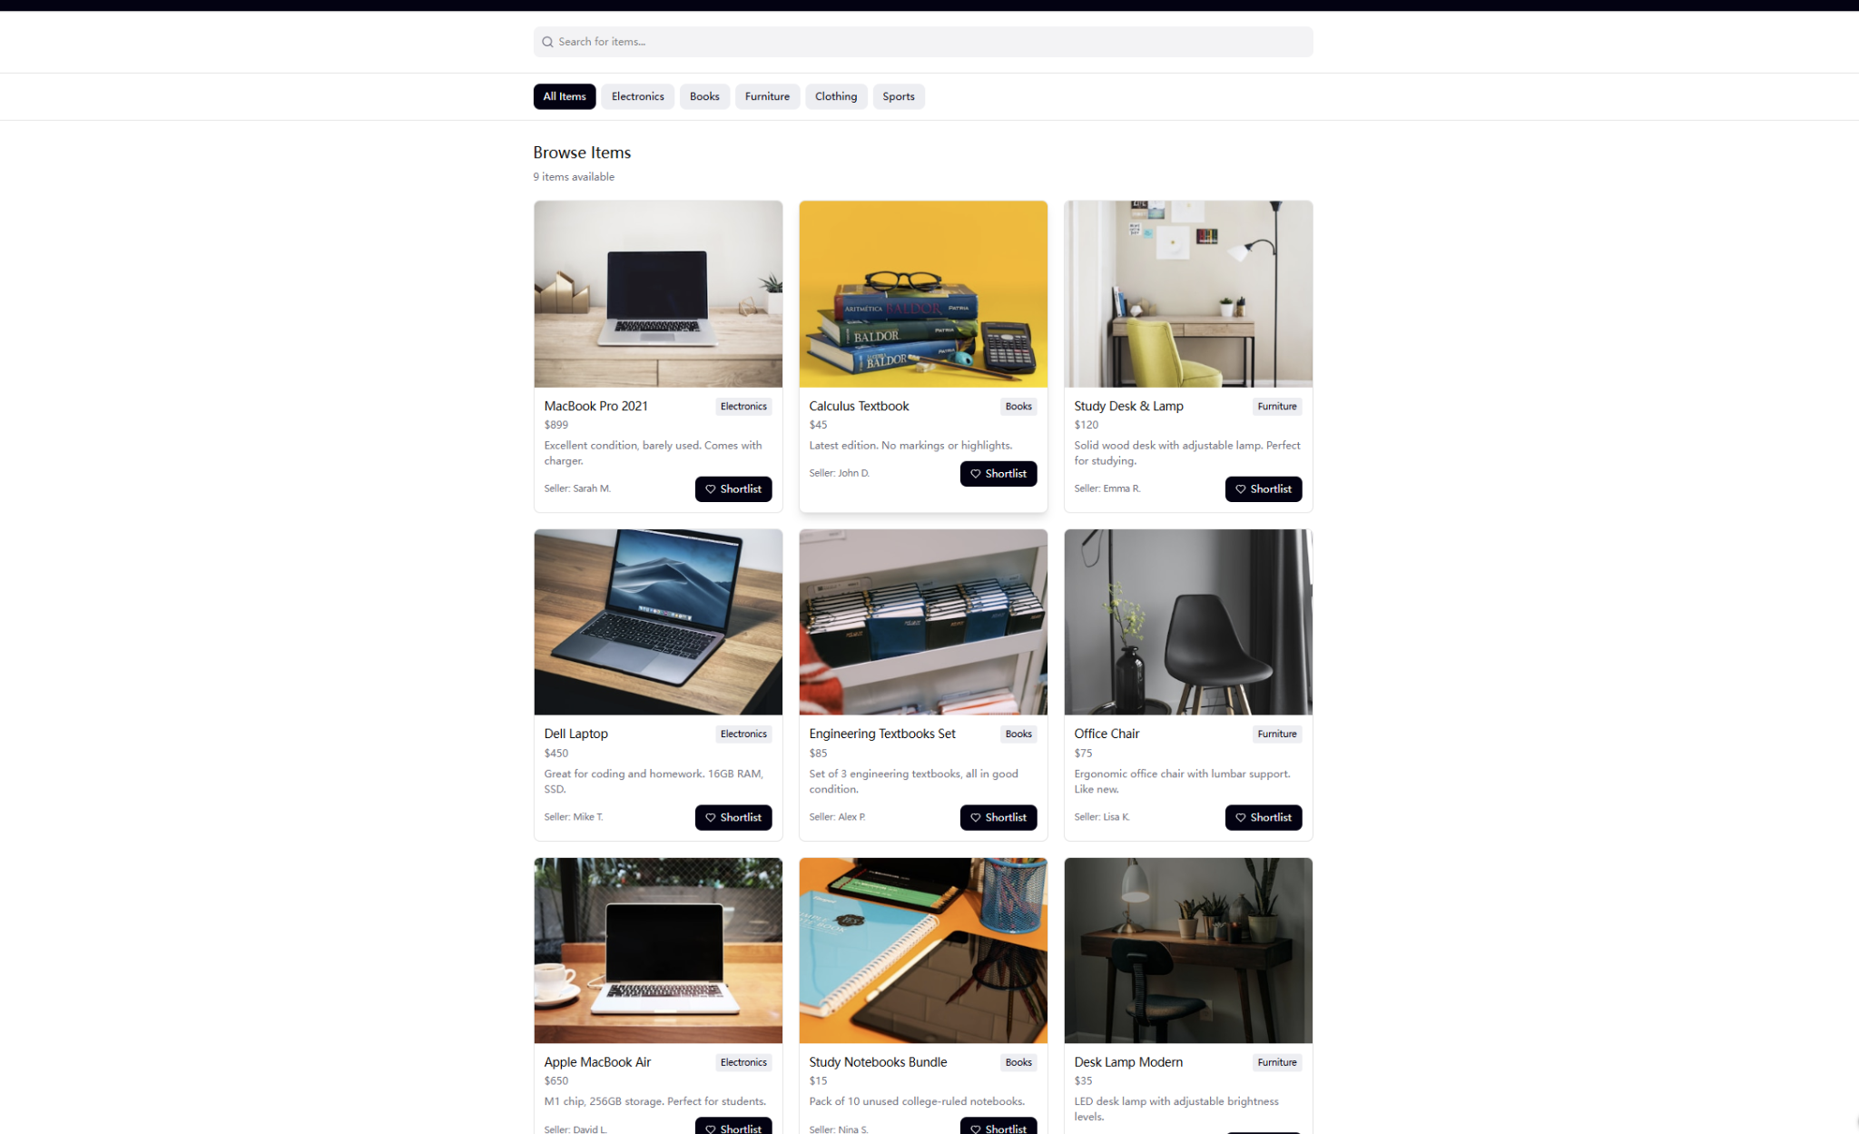
Browse Marketplace Page
marketplace.html
Figma Design
1.Connect front-end webpage with Firebase Firestore database Fetch all goods data from items collection and auto-generate product cards dynamically
2.Render item name, description, price, category and seller information on page Add Add to 3.Shortlist button: save goods into shortlist collection with current user’s UID
4.After saving, auto redirect to My Shortlist page developed
5.Login verification: unlogged users will be forced to redirect to login page

Slide 5
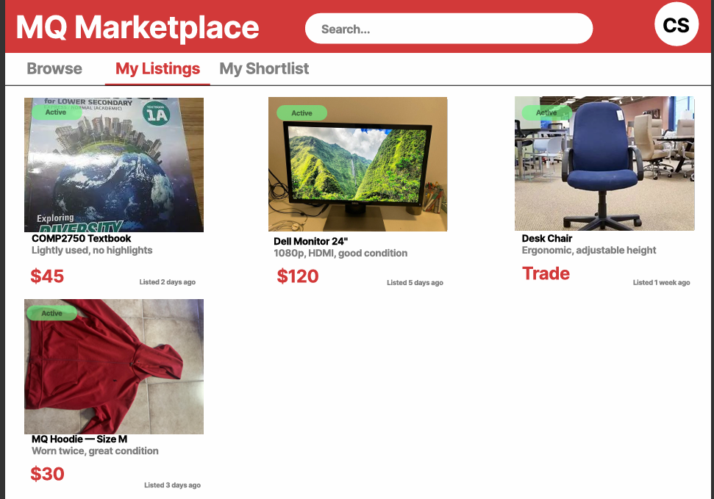
My Listings Page
Callum Sonter
mylistings.html
Figma Design
Queries Firestore items filtered by sellerId
Only shows items belonging to signed-in user
Displays name, description, price, category, seller
Handles Trade items and image placeholders
Auth guard redirects unauthenticated users

Slide 6
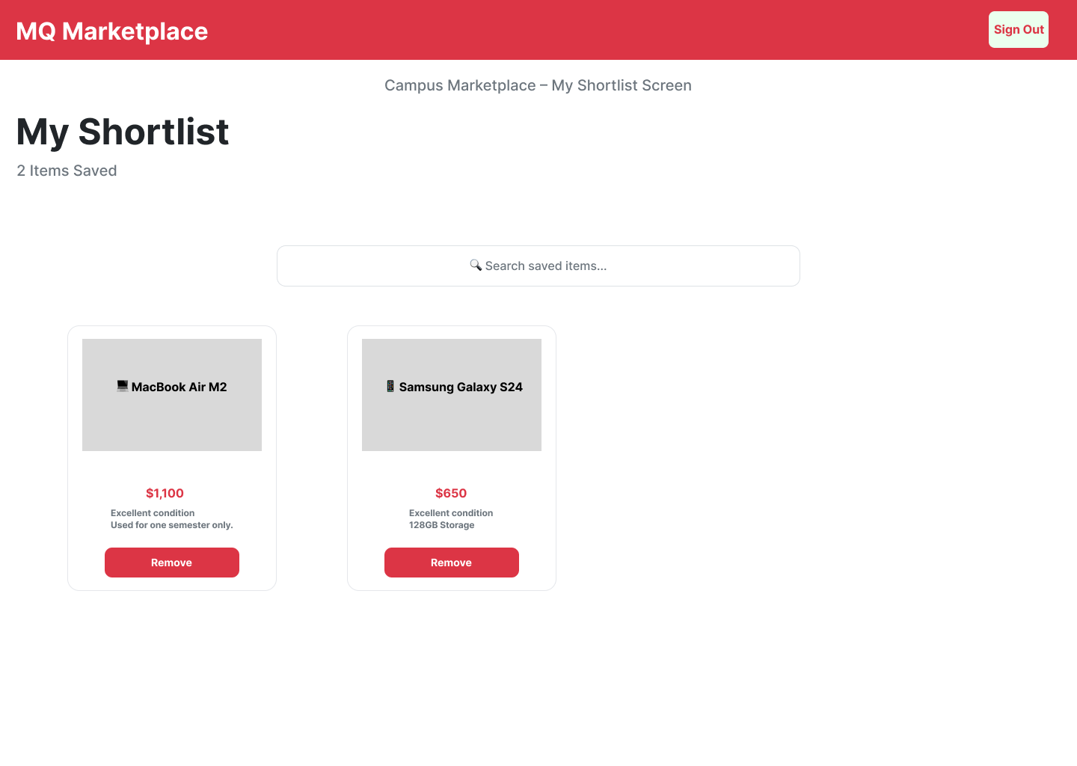
My Shortlist Page
Zhang Bowei
shortlist.html
Figma Design
1. Created My Shortlist page connected to Firebase Firestore
2. Fetch shortlisted items for the currently signed-in user using their UID
3. Display shortlisted item name, description, price, category and seller information
4. Show total number of shortlisted items
5. Allow users to remove items from their shortlist
6. Automatically update Firestore and refresh the displayed shortlist after removal
7. Login verification: unauthenticated users are redirected to the login page

